Slide 1
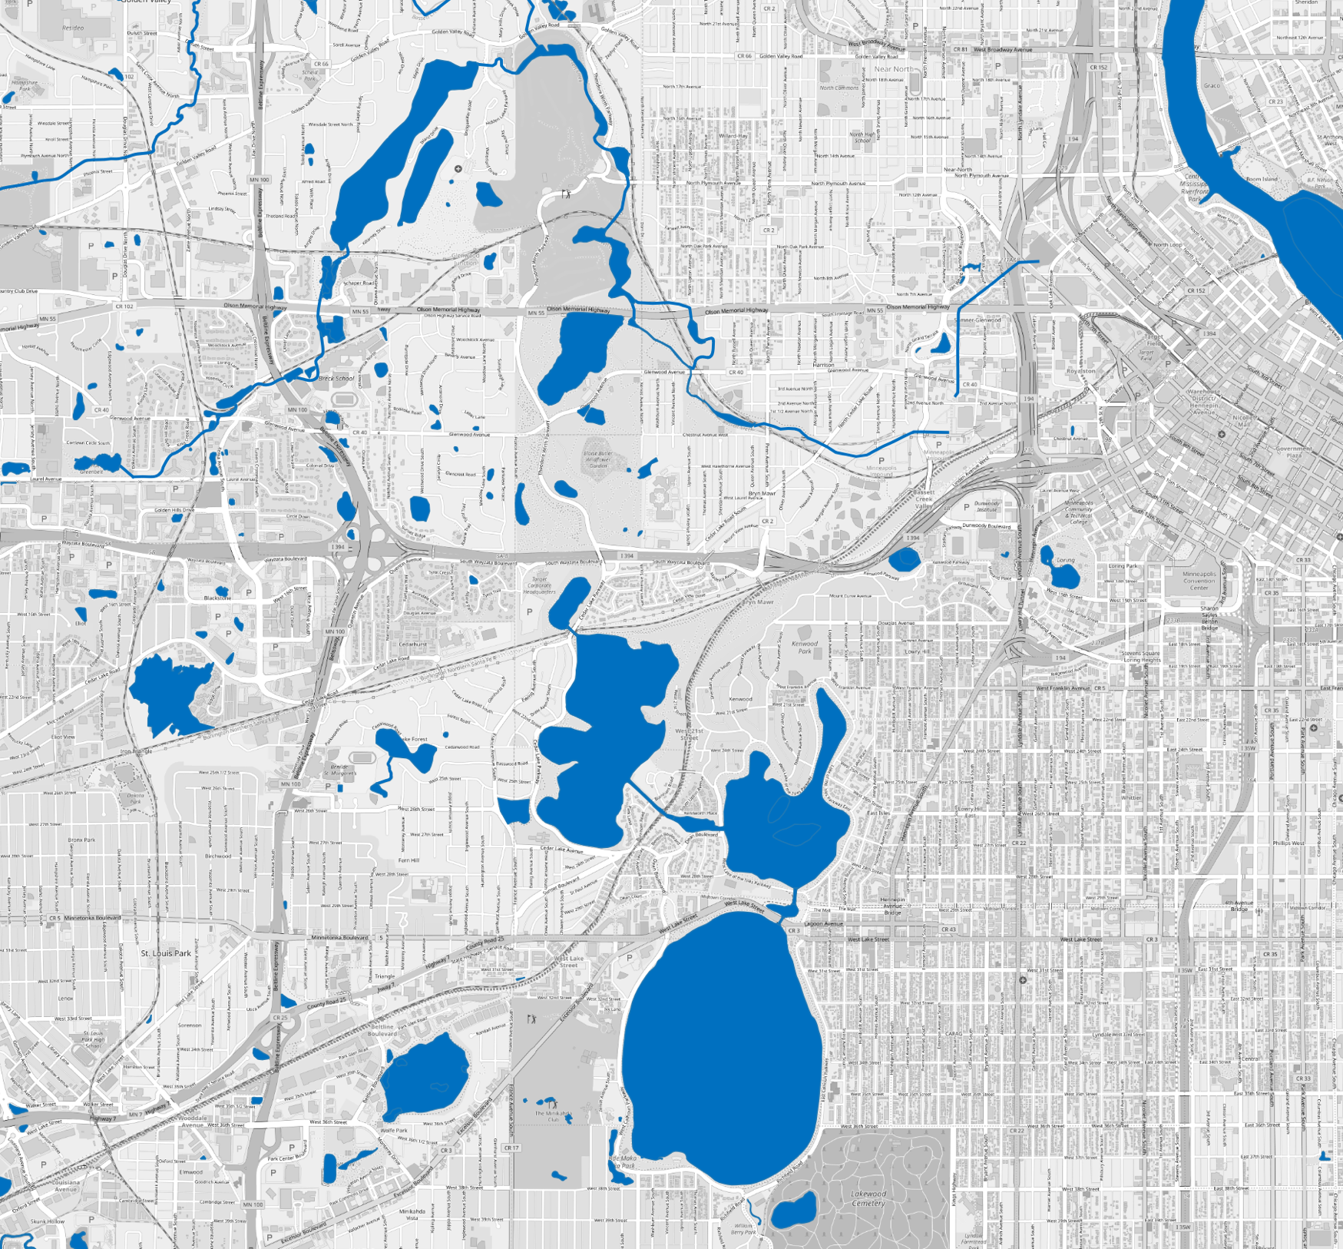

OSM WATER:
How well are Minnesota’s water features mapped?
SOTM-US 2019, Minneapolis
Matthew Manley
Bentley Breithaupt
Alex Sweeney
Notes:
MATT:
Hello! My name is Matt Manley and I’m a GIS data analyst at Critigen.
BENTLEY:
And I’m Bentley Breithaupt, a GIS developer at Critigen
We both will be sharing a project with you today called: OSM WATER: How well are Minnesota’s water features mapped?

Slide 2
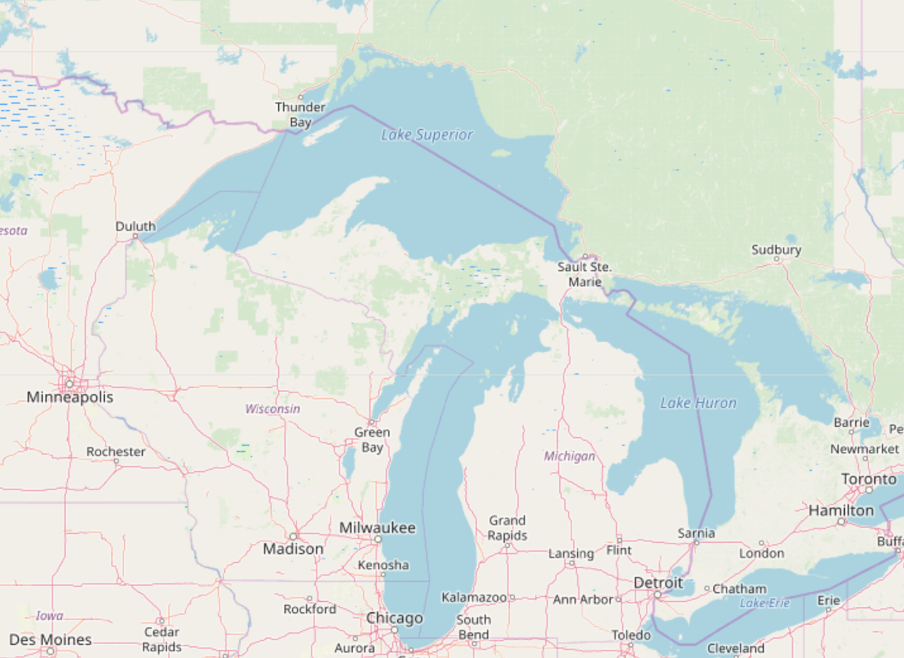
The Role of Water in OSM
Why water?
Provides geographic context
An important natural resource
Can act as a barrier or facilitator of human movement
An interesting case study concerning the role of bulk imports in OSM
Notes:
MATT:
To start, we wanted to provide some context on why we are focusing on water.
Water features, along with other natural features provide important geographic context in OSM.
They are also an important natural resource – so knowing where water features are is important.
Water can also be an important barrier or facilitator to human movement. Other OSM features such as bridges, piers, and ferry routes are linked to our representation of water in OSM.
Analyzing water presents a great opportunity to study the role of bulk imports in OSM.

Slide 3
highway: *
waterway: *
natural: water
OSM Feature Counts in Minnesota
Count of Features
TIGER
Import
NHD Import
Source: https://ohsome.org/apps/dashboard/
Notes:
MATT:
We will get back to bulk imports in a second, but
One other reason why we chose water is that it has been traditionally undermapped in OSM.
This graph shows the usage of natural=water and waterway tags vs. highway tags over time in Minnesota
While feature counts don’t tell the whole story, this graph illustrates two things.
The first is that there is a difference in the relative rates of feature creation over time between road features and water features.
The second is how important bulk imports are in contributing to map completeness.

Slide 4
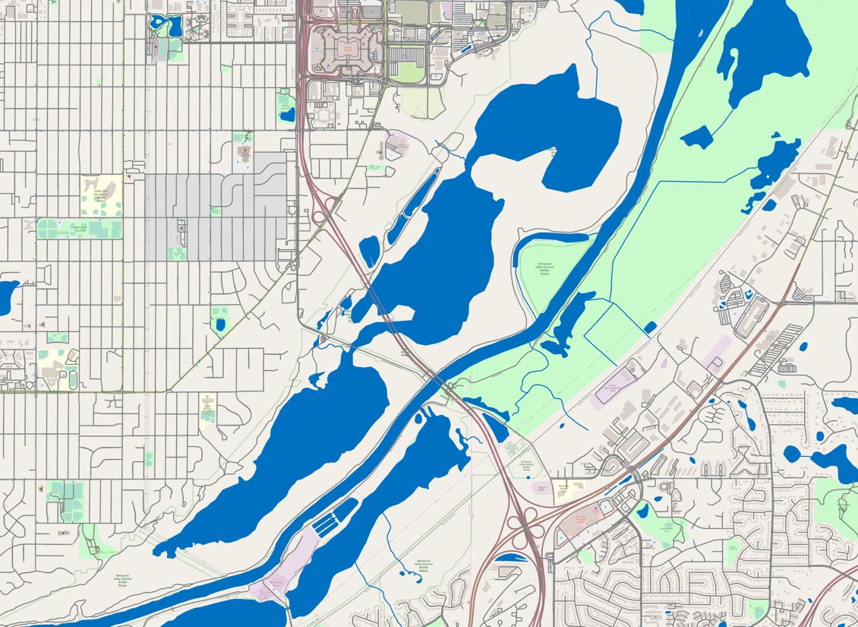
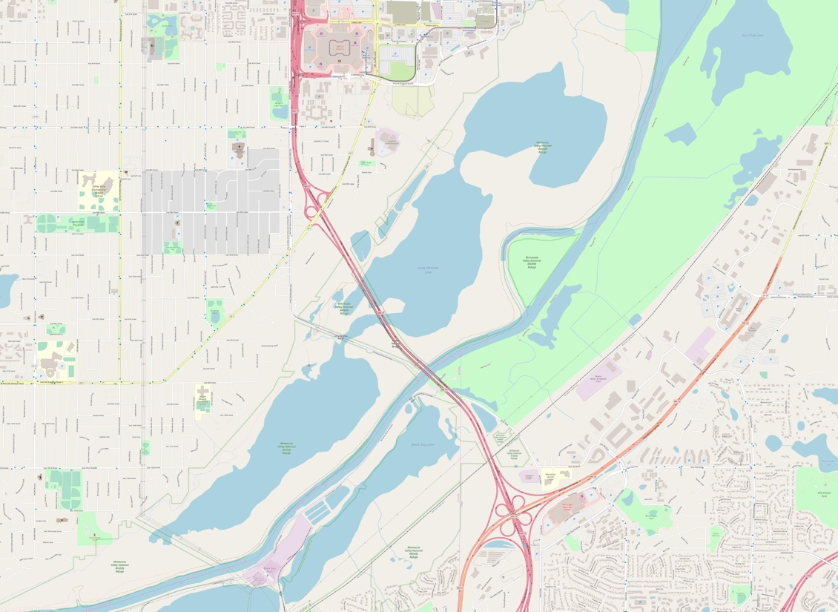
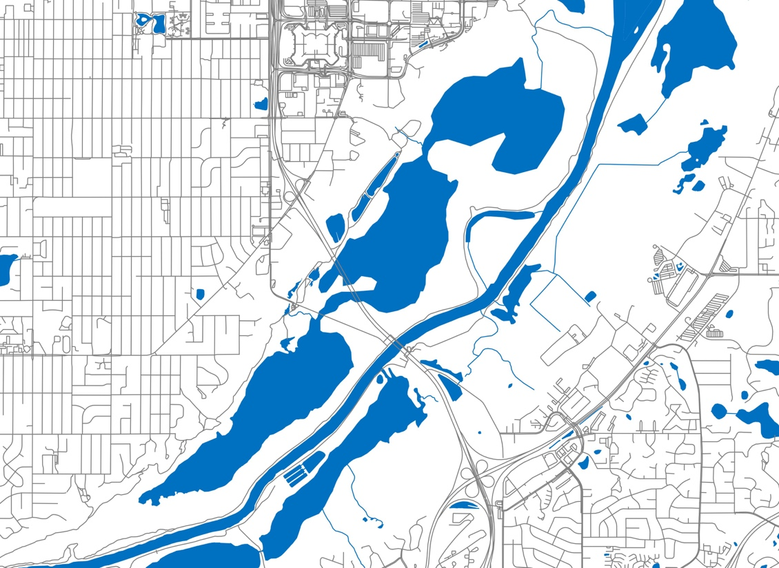
Bulk Imports
“Importing is the process of uploading external data to OSM.”
Supplements user-created data
Involves a complex merging process
Examples include:
TIGER data (US Census Bureau)
Bing Maps (Microsoft) building footprint data
Notes:
MATT:
Ok so coming back to bulk imports now
Just as some background, the OSM wiki defines bulk imports to be the process of uploading external data to OSM.
This data acts as a supplement to user-created data
And usually involves a complex merging process to get the data into OSM
There are numerous examples of data that has been imported in this way, but some examples in the US include TIGER data and Bing Maps building footprint data

Slide 5





Bulk Imports – Pros & Cons
One of the most controversial topics within the OSM community¹
PROS
CONS
May discourage users from making additional edits³
Can be a complicated process that takes a lot of community input⁴
May introduce errors if external source is not accurate
Can increase map completeness²
Validation feedback loop between external source and OSM community¹
Notes:
MATT:
Bulk imports have been a pretty controversial topic in the OSM community for some time.
This is largely due to the nature of bulk imports. Importing external data is at odds with the core model of OSM – where users manually add verifiable data to the map.
There are however some pros to using bulk imports:
Due to the amount of data being imported, imports can increase map completeness
They can also provide an opportunity for a validation feedback loop between the external source and the OSM community. In this case, edits made in OSM would be validated and then added to the external source, thus creating a mutually beneficial relationship.
Some cons include:
Bulk imports may discourage users from making additional edits. The idea here is that if the map already appears complete, users may not feel motivated to make additional edits.
Further, bulk importing data can often be a complicated process that involves a lot of discussion and planning within the community. Transforming an external data source to the OSM data model is no small task in some cases, especially if the two types of data are very different.

Slide 6
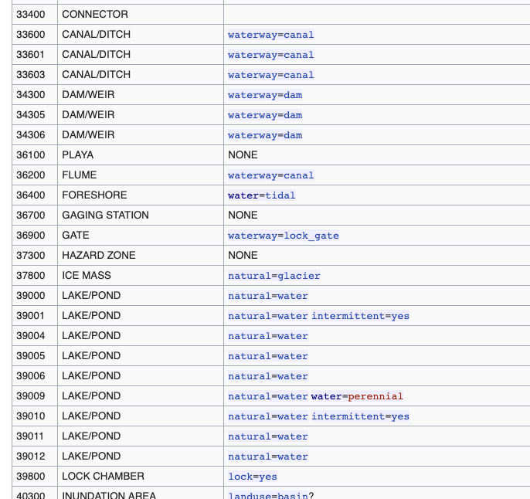
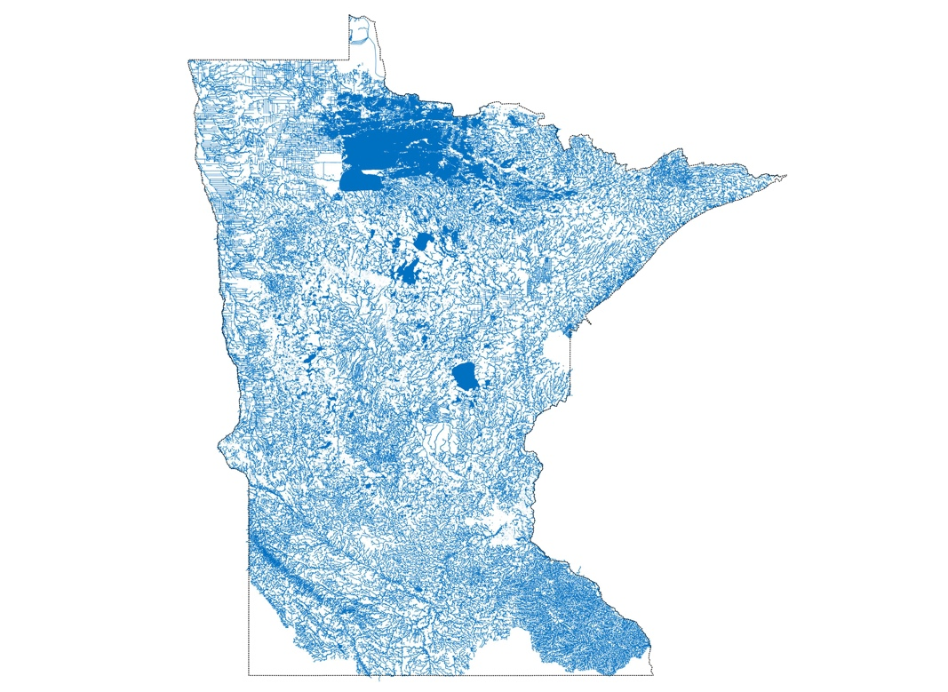
NHD
The National Hydrography Dataset (NHD) is managed by the USGS National Geospatial Program https://www.usgs.gov/core-science-systems/ngp/national-hydrography.
How does NHD figure into OSM?
Bulk uploaded to OSM in multiple steps
Complex import process to correctly map the NHD data to corresponding OSM tags
Names used when available
Notes:
MATT:
Despite all this back and forth, bulk imports have become important sources of data within OSM
One such external source of data is The National Hydrography Dataset or NHD
This is a rich dataset that represents the water drainage network of the United States. It is managed by the USGS.
NHD was bulk imported into OSM in multiple steps and involved a complex tag mapping process. A sample of that process is shown at right, where different NHD feature types are mapped to OSM tags.

Slide 7

Research Questions
What is the state of water data in OSM?
What role does NHD play in the representation of water features?
Case-study: Minnesota
How has bulk-imported NHD data changed since import?
Notes:
MATT:
In terms of our research questions, we started broadly with the question: What is the state of water data in OSM?
From there, we ask what role does NHD play in the representation of water features in OSM
We used Minnesota as a case study in analyzing how bulk-imported NHD data has changed since import

Slide 8



Methodology
Define
inland water
Extract inland water for 2009, 2011, & 2019
Identify changes in NHD data between 2011-2019
Classify and visualize changes
Notes:
BENTLEY
Our study is divided into 4 parts:
First, what we mean by ‘water features’ and ‘inland water’
Next, where we got our data, and how we prepared it
After that, how we identified NHD data and changes to it
And finally, our classifications of changes to NHD bulk imports
We will be going over each of these in this presentation.

Slide 9
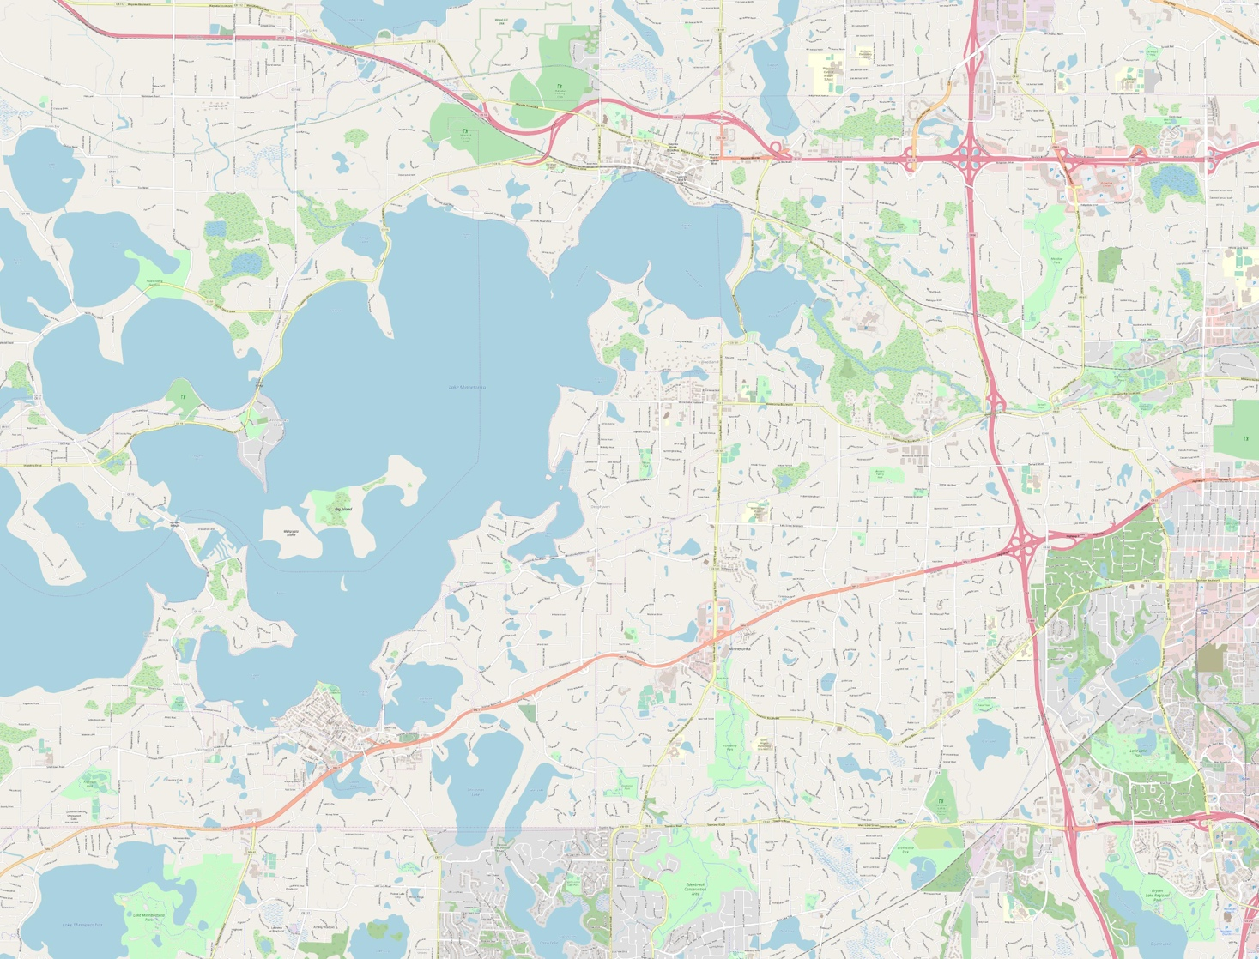
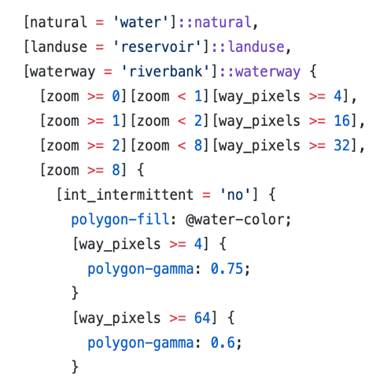

Inland Water Definition
Start with OSM basemap
Use CartoCSS Style Sheet
Select tags for ‘Inland Water’
https://github.com/gravitystorm/openstreetmap-carto/blob/master/water.mss
Notes:
BENTLEY
For this study we needed to define the water features we were investigating.
We decided to use the standard OSM base map as are starting place for this definition.
The base map uses carto style sheets to define how features are visualized, based on their tags.
We used a subset of the tags used in the water style sheet to create a definition for what we have termed ‘inland water’.

Slide 10
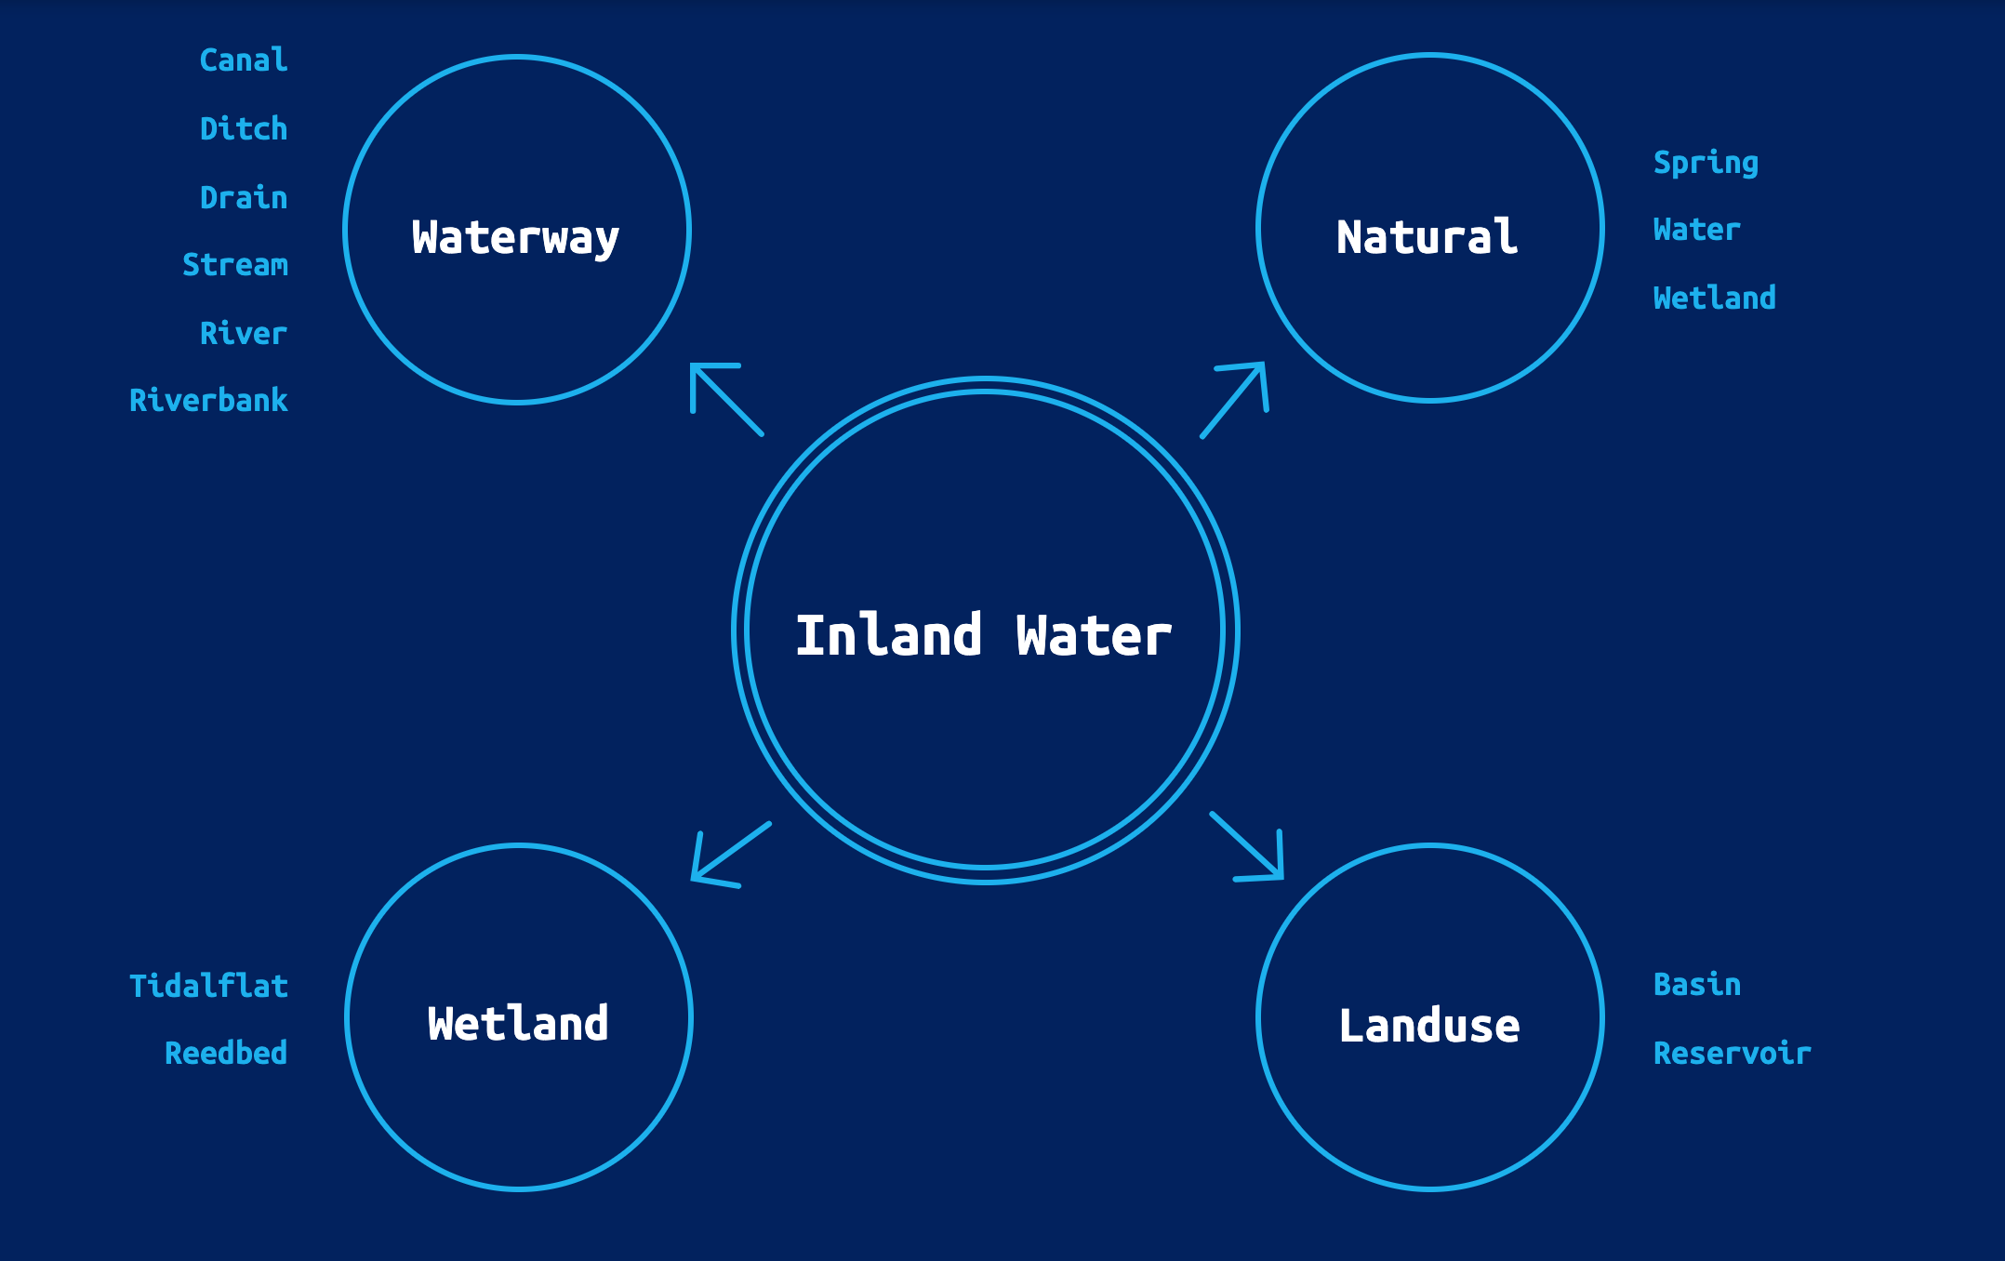
Inland Water Definition
Notes:
BENTLEY
Our water feature definition is for ‘inland water’, as opposed to all water, due to the location of out study and the nature of the NHD dataset we were investigating.
In general the definition is pretty self explanatory, we wanted to capture all water features that are traversing or surrounded by land, and for the most part that means fresh water.
Here you can see the exact OSM tags that we used in our definition. Values from the Waterway, Natural, Wetland, and Landuse tags make up the entirety of it.

Slide 11
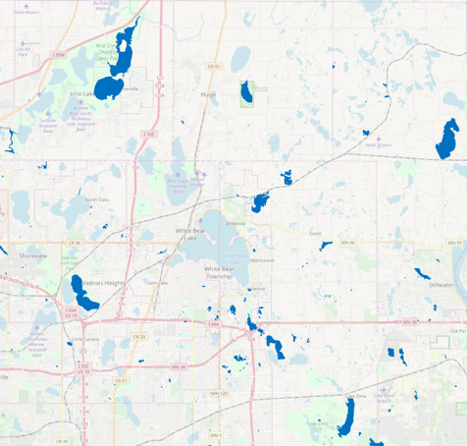
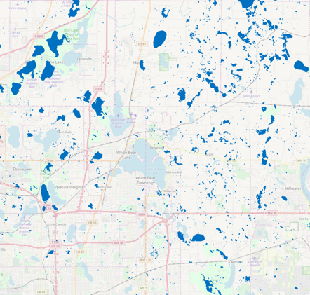
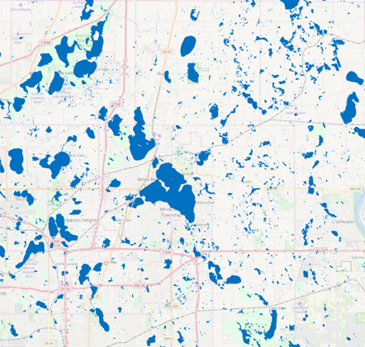
Time-Slices
9/30/2009
Represents pre-NHD bulk import
9/30/2011
Directly after the majority of bulk imports
4/7/2019
Recent data representing the “current state”
Notes:
BENTLEY
Once we had our inland water definition the next thing we needed was a way to look at bulk imported NHD data, and how it has changed over time.
Our way of doing this was by creating time slices of OSM data. You can think of these like snapshots of what the OSM dataset looked like a specific point in time.
Based on some research into when most of the NHD data was first imported into OSM, we decided to create three time slices.
One from 2009, that is pre NHD import.
One from 2011, that is just after most of the NHD data was first imported.
And one from earlier this year, representing the present dataset at the time we started this study.

Slide 12
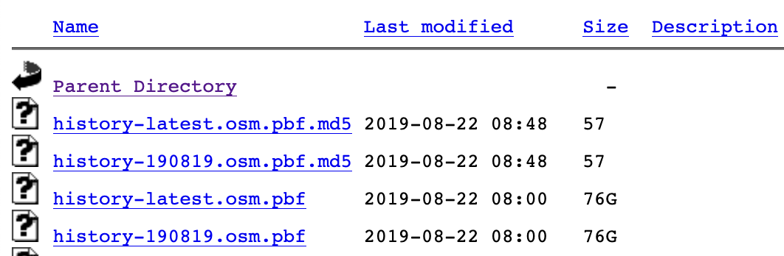




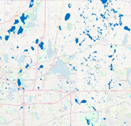
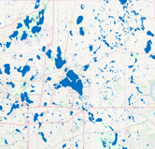
Generating Time Slices
Data from full OSM history PBF file
Data processed using Osmium Tool
History file soft clipped to Minnesota
3 time slices extracted
Time slices filtered to items from inland water definition
Notes:
BENTLEY
The time slices we used were extracted from a full OSM history file, in PBF format.
This file was processed using an open source application called Osmium Tool, that has many useful features for working with OSM data in both regular and history representations.
The first thing that was done was to extract all data that intersected or overlapped the area of Minnesota.
Next, the data was cut into the three previously mentioned time slices, using Osmium’s time-filter feature.
Finally, each time slice was filtered to only include items that matched our inland water definition.
At this stage we had three PBF files, each containing the water features of Minnesota at a different point in time.

Slide 13
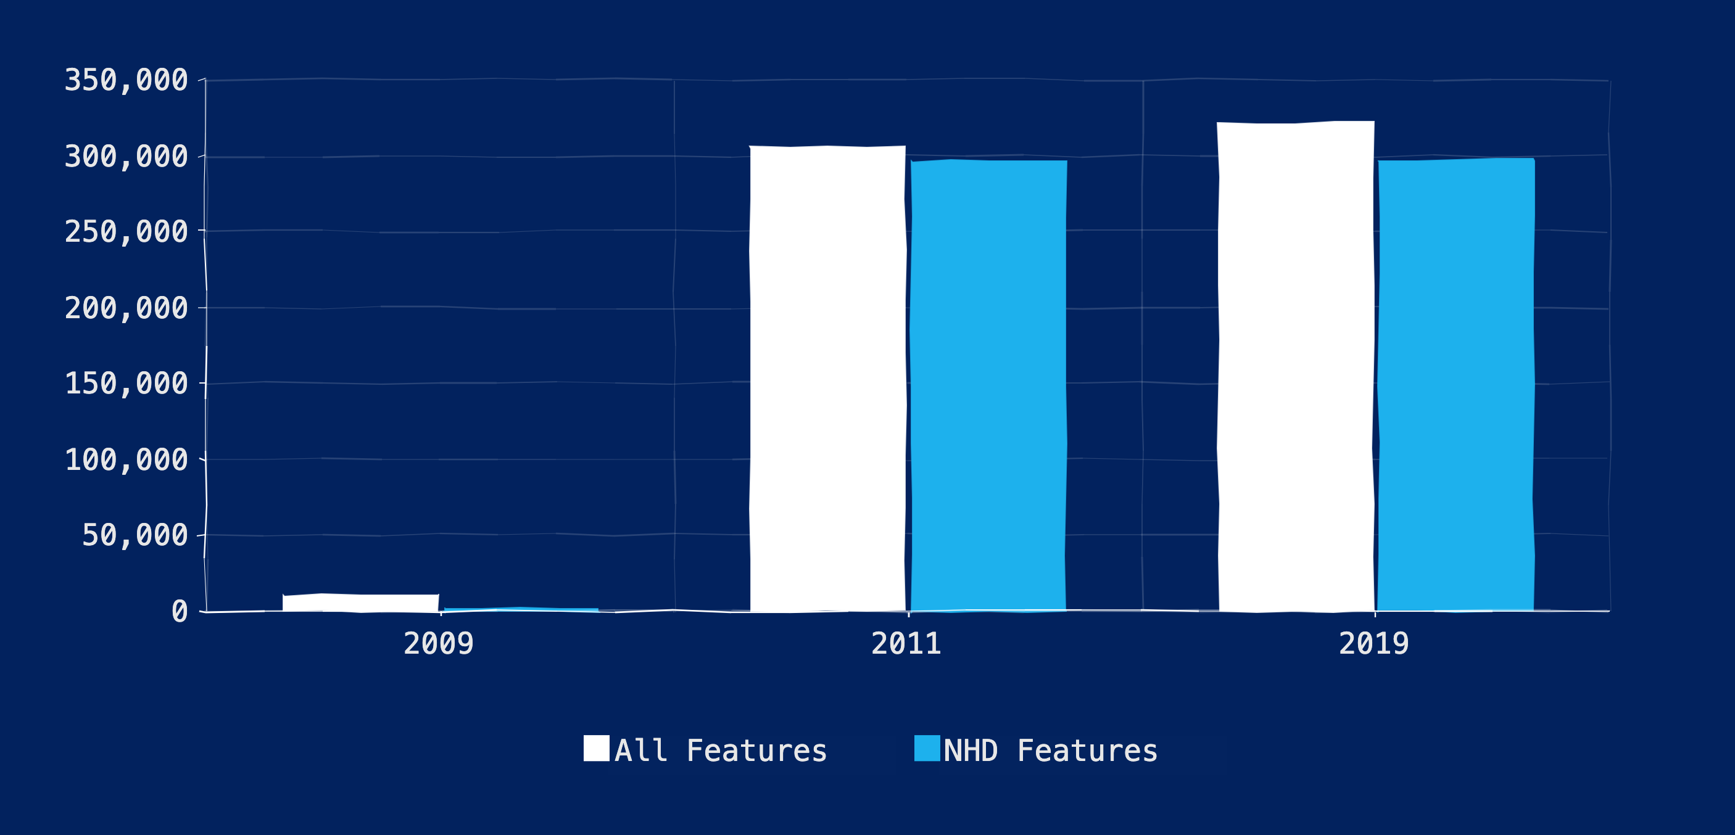
Count of MN Inland Water Features
Notes:
MATT:
So how do our time slices compare?
This graph shows NHD features vs. all features for each time slice.
Again, we include 2009 to indicate what OSM looked like before the bulk import of NHD
As you can see, from 2009-2011 about 300,000 features were added, mostly sourced from NHD.
While there is some change between 2011 and 2019, the number of NHD features remained relatively static.

Slide 14
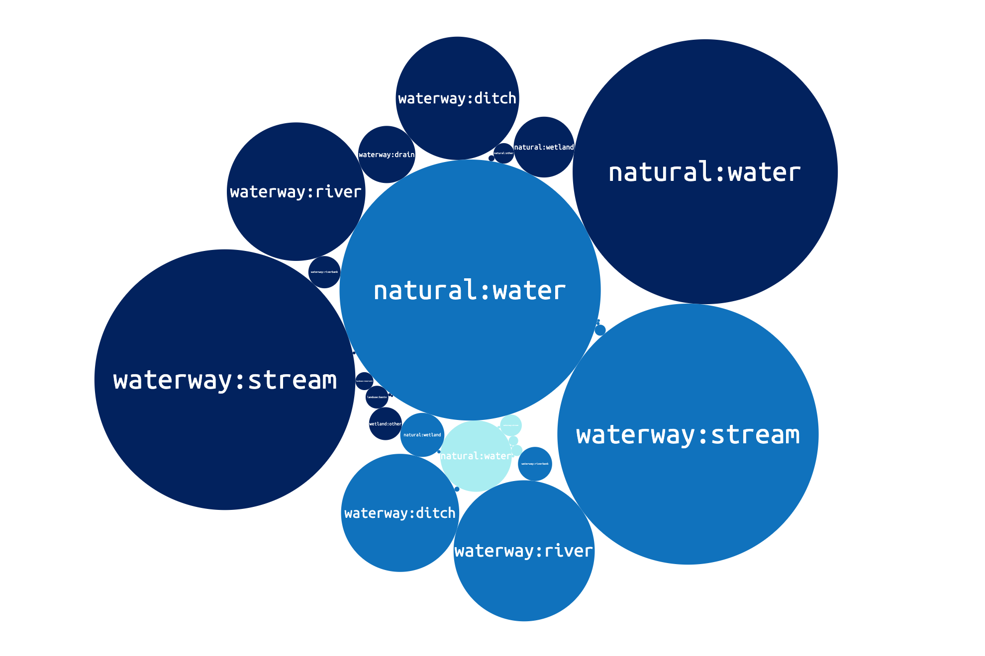
natural:water
2009
2011
2019
Notes:
MATT:
We wanted to show the prevalence of inland water tags per time slice.
The main points here are that the largest number of features have tags natural : water, waterway : stream, waterway : river, and waterway : ditch.
The rest of the tags that we used to define inland water make up a much smaller percent of the whole.
Again we can see the huge jump in feature counts from 2009 to 2011 based on the proportional sizes of the bubbles
Another interesting trend to note is that the tags waterway : river, waterway : riverbank, and waterway : stream actually decreased from 2011-2019
This is likely due to changes in tagging practices, especially with how NHD feature types were given specific tags.

Slide 15
Moving beyond the bulk import
How has NHD data changed
2011-2019?
Notes:
MATT:
Up until this point, we’ve been using feature counts to describe change between time slices.
Now we are going to walk through our analysis of geometric change in NHD features from 2011-2019.
This tells us how bulk imported data changes over time with the help of the OSM community.

Slide 16

How did we define change?
2011
Does this feature exist in some form in both years with different IDs?
Does OSM ID exist in both years?
NO
NO
What year does this feature solely exist in?
YES
2019
Did the geometry change 2011-2019?
NO
YES
YES
2011
2019
NO CHANGE
CHANGE IN GEOMETRY
REPLACED
DELETED
ADDED
CHANGE
Notes:
MATT:
This flowchart indicates our general methodological approach for this analysis.
We started with our two time slices for 2011 and 2019, filtered to only include data that was derived from NHD.
We then looked to see whether the OSM ID exists in both time slices.
If it does, we can query to find whether the geometry changed between the two time slices.
If the geometry did not change, then we classified the feature as NO CHANGE
If the geometry changed at all, then we classified the feature as CHANGE IN GEOMETRY
Stepping back, if the OSM ID did not exist in both years, we tested whether the feature was replaced by another feature, but with a different ID.
If this was the case, then the feature was REPLACED
If the feature does not get replaced we check what time slice this feature is in.
If the feature only exists in 2019 then we consider it an ADDITION
If the feature only exists in 2011 then we consider it a DELETION

Slide 17
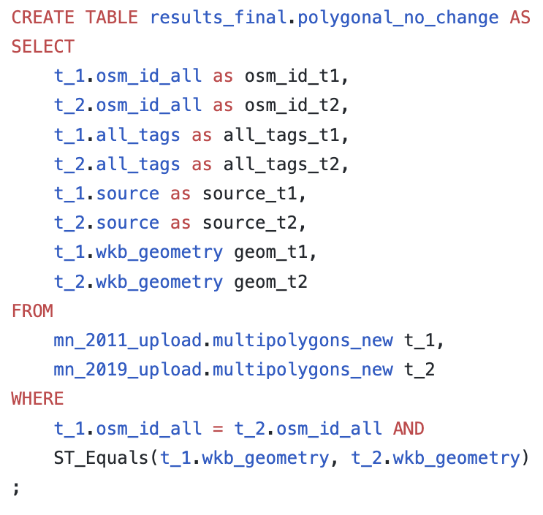
Querying for Change
Used PostgreSQL and PostGIS
Started by querying for no-change vs. change
https://github.com/spatialdev/mn-water-2019
Notes:
MATT
In order to identify our various types of change we uploaded our 2011 and 2019 PBFs to a Postgres instance and used PostGIS functions to identify changes
We started by querying for no-change vs. change. The query on the right shows an example of how we identified polygonal features that did not change.
Essentially we join on osm_id and identify whether the geometries are equal or not using the PostGIS function ST_Equals
After identifying the features that changed we further broke up the change into those 4 types of changes in geometry, replacements, deletions and additions

Slide 18
Change in Polygonal Features 2011-2019
Notes:
MATT:
Given that logic, we can see how NHD features fared from 2011-2019.
This chart shows the classification of polygonal features.
The vast majority of polygonal features did not change from 2011-2019.
The 11% that did change is comprised mostly of changes in geometry followed by deletions, additions, and replacements.

Slide 19
Change in Linear Features 2011-2019
Notes:
MATT:
This chart shows the classification of linear features.
Again, the vast majority of linear features did not change from 2011-2019. However, a larger proportion of linear features changes than polygonal features.
The 17% that did change is comprised mostly of changes in geometry followed by additions, deletions, and replacements.

Slide 20
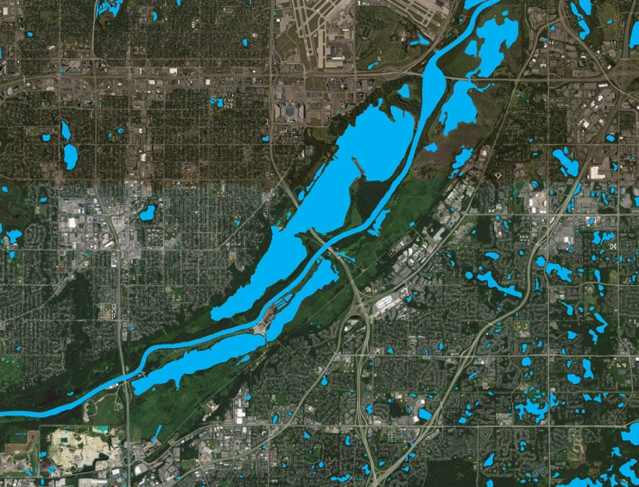
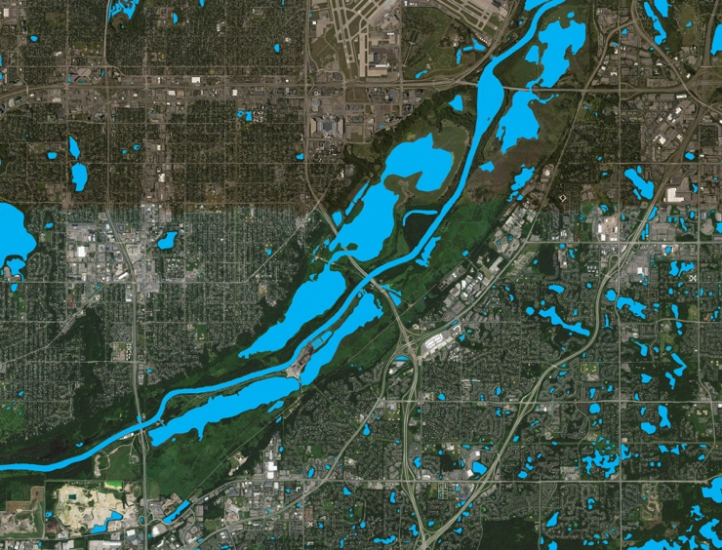
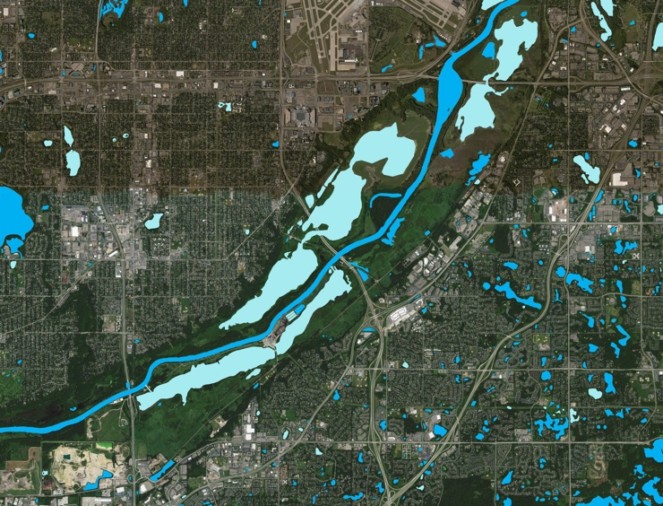
Illustrating Change
2011
2019
Change
Notes:
MATT:
For the next few slides we will be illustrating change in water data
In order to do that we will show three images per set
The first will be an image of the features in 2011
The second will be an image of the features in 2019
And the final image will indicate the features that changed between our two time slices

Slide 21

Changes in Geometry
2011
Notes:
MATT:
We’ll start by showing an example of change in geometry.
This image shows features in 2011.

Slide 22

Changes in Geometry
2019
Notes:
MATT:
This image shows features in 2019.

Slide 23
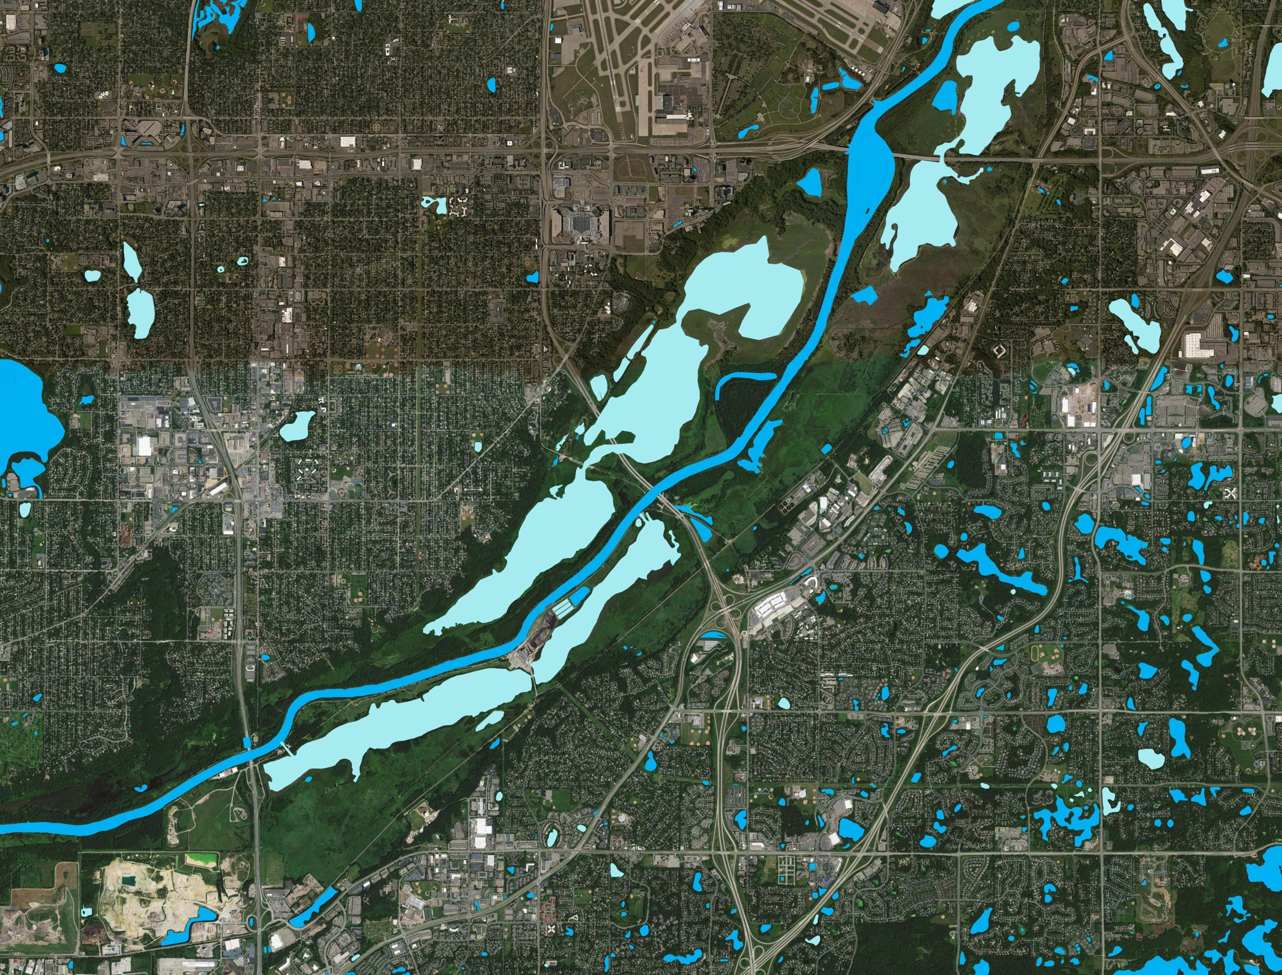
Changes in Geometry
2019
Notes:
MATT:
And finally this image shows features that were classified as having changes in their geometry between 2011-2019

Slide 24
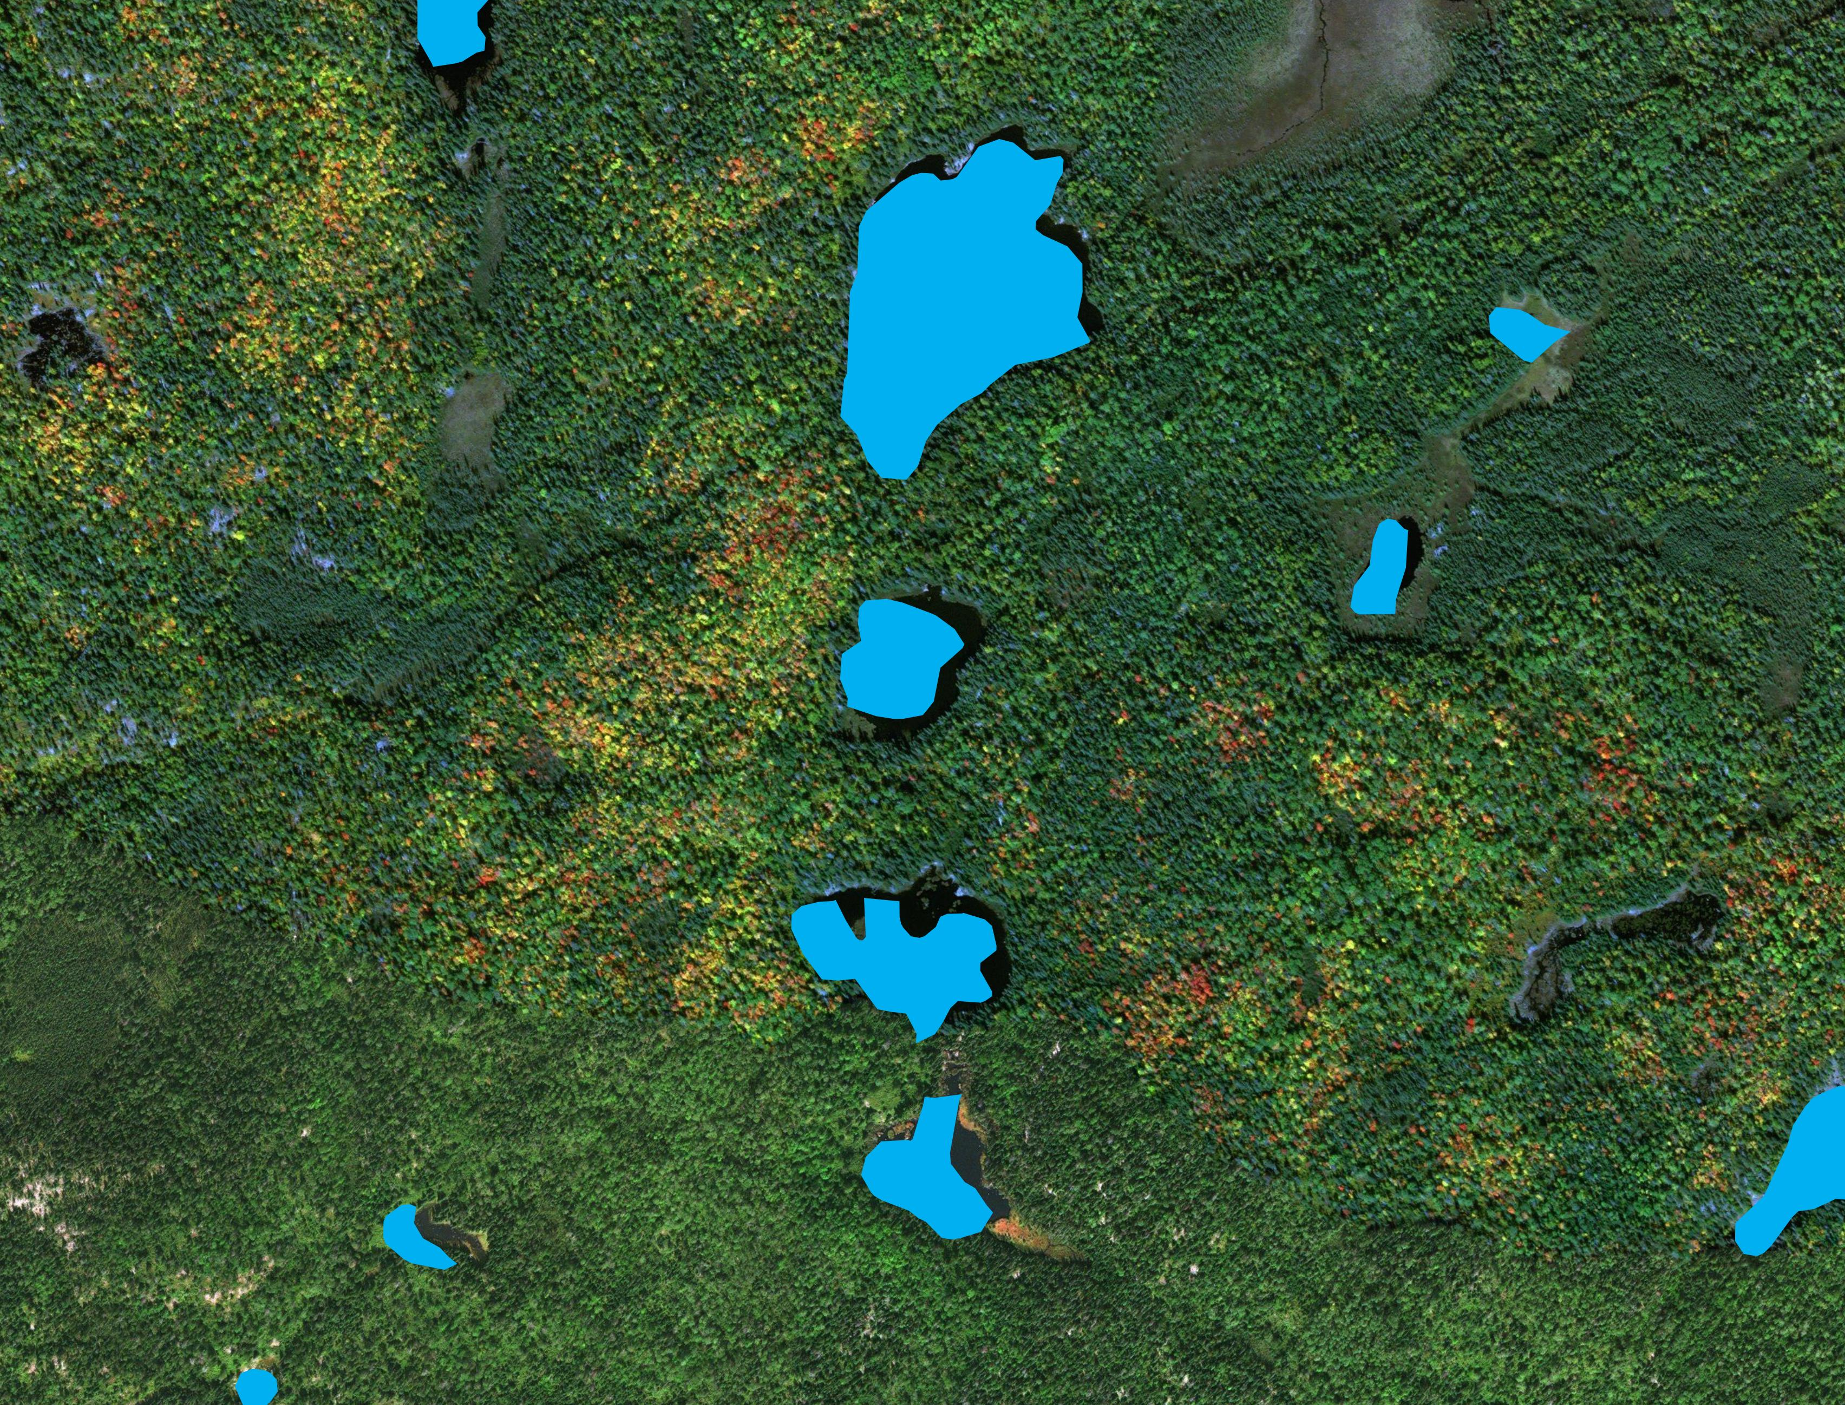
Replacements
2011
Notes:
MATT:
This next set of images will show the concept of replacement.
This image shows features in 2011.

Slide 25
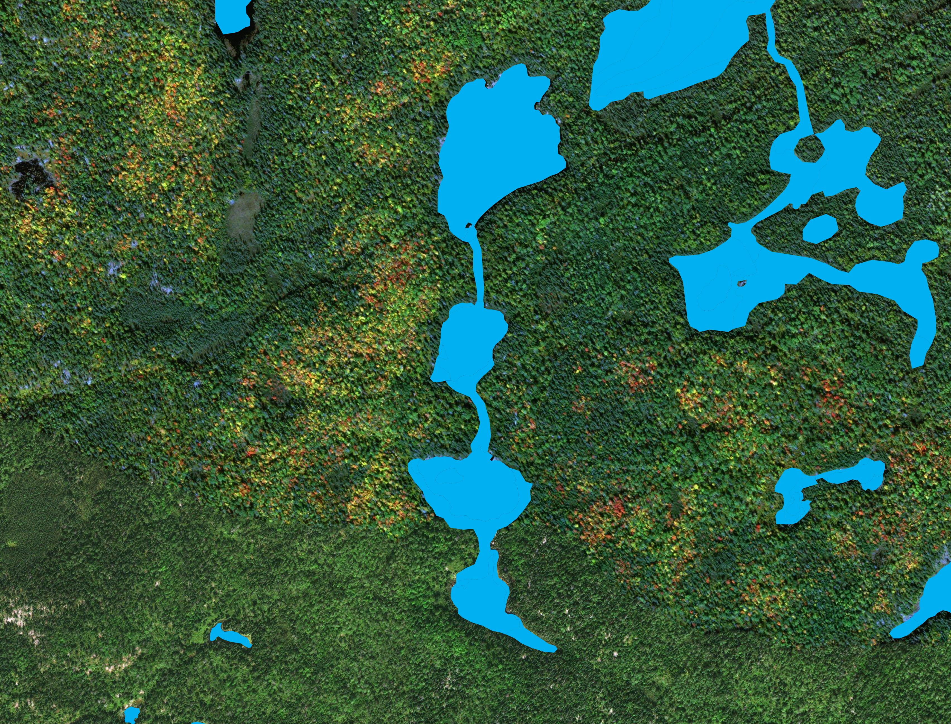
Replacements
2019
Notes:
MATT:
This image shows features in 2019

Slide 26
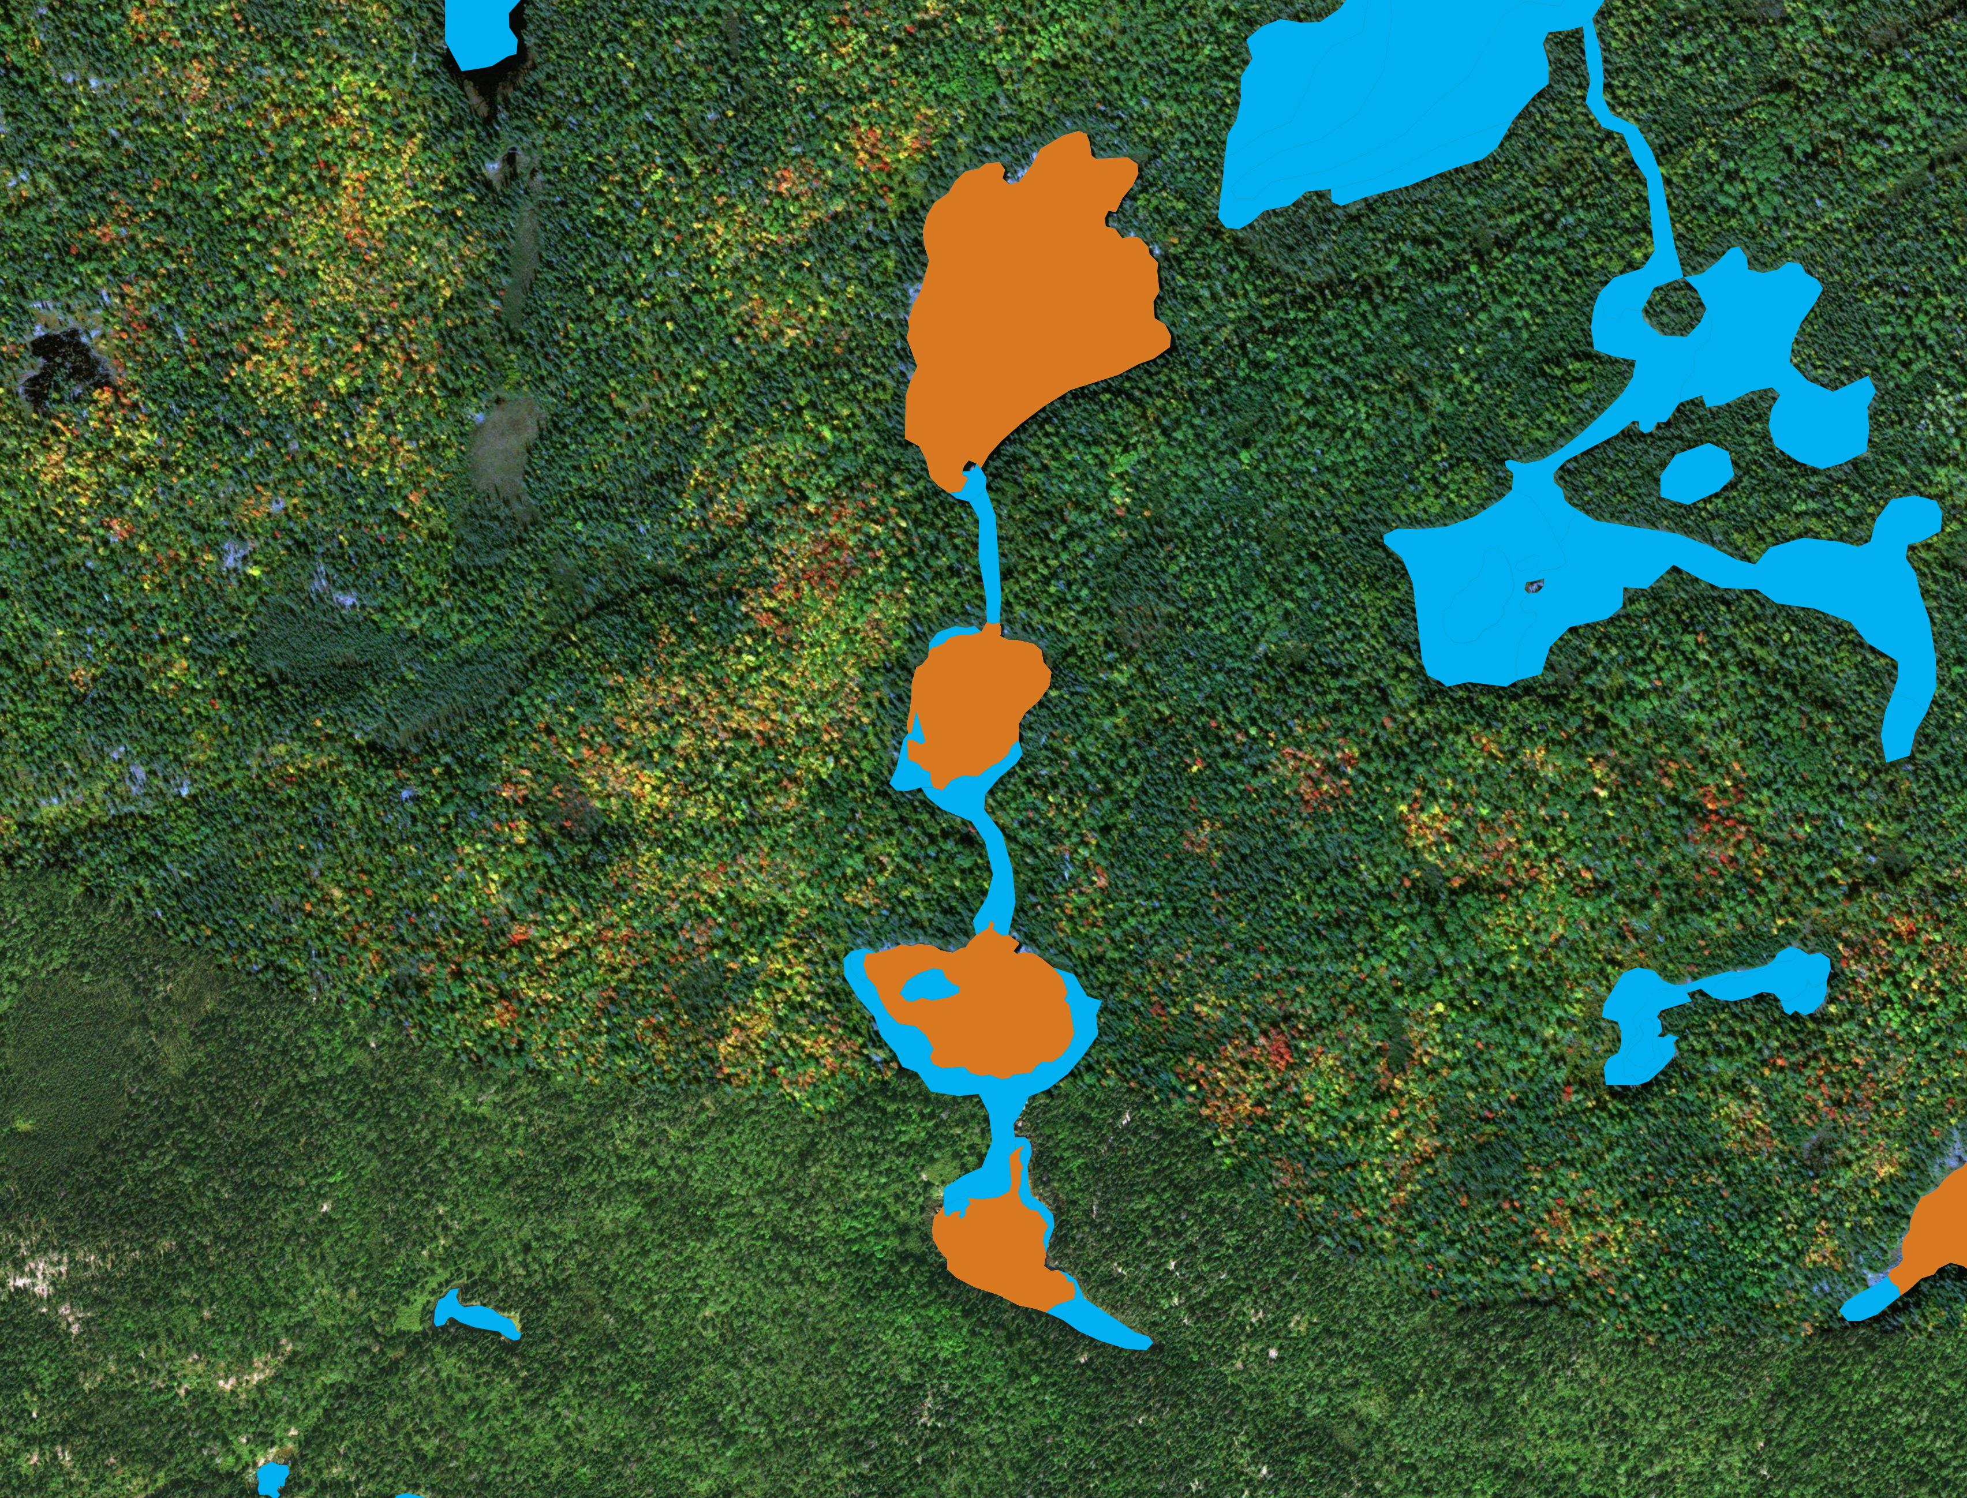
Replacements
2019
Notes:
MATT:
And finally here we have features that were classified as replacements shown in orange.
These features have different IDs than those in 2011 and occupy the same geographic area. We view these features as replacements for older features in 2011.

Slide 27
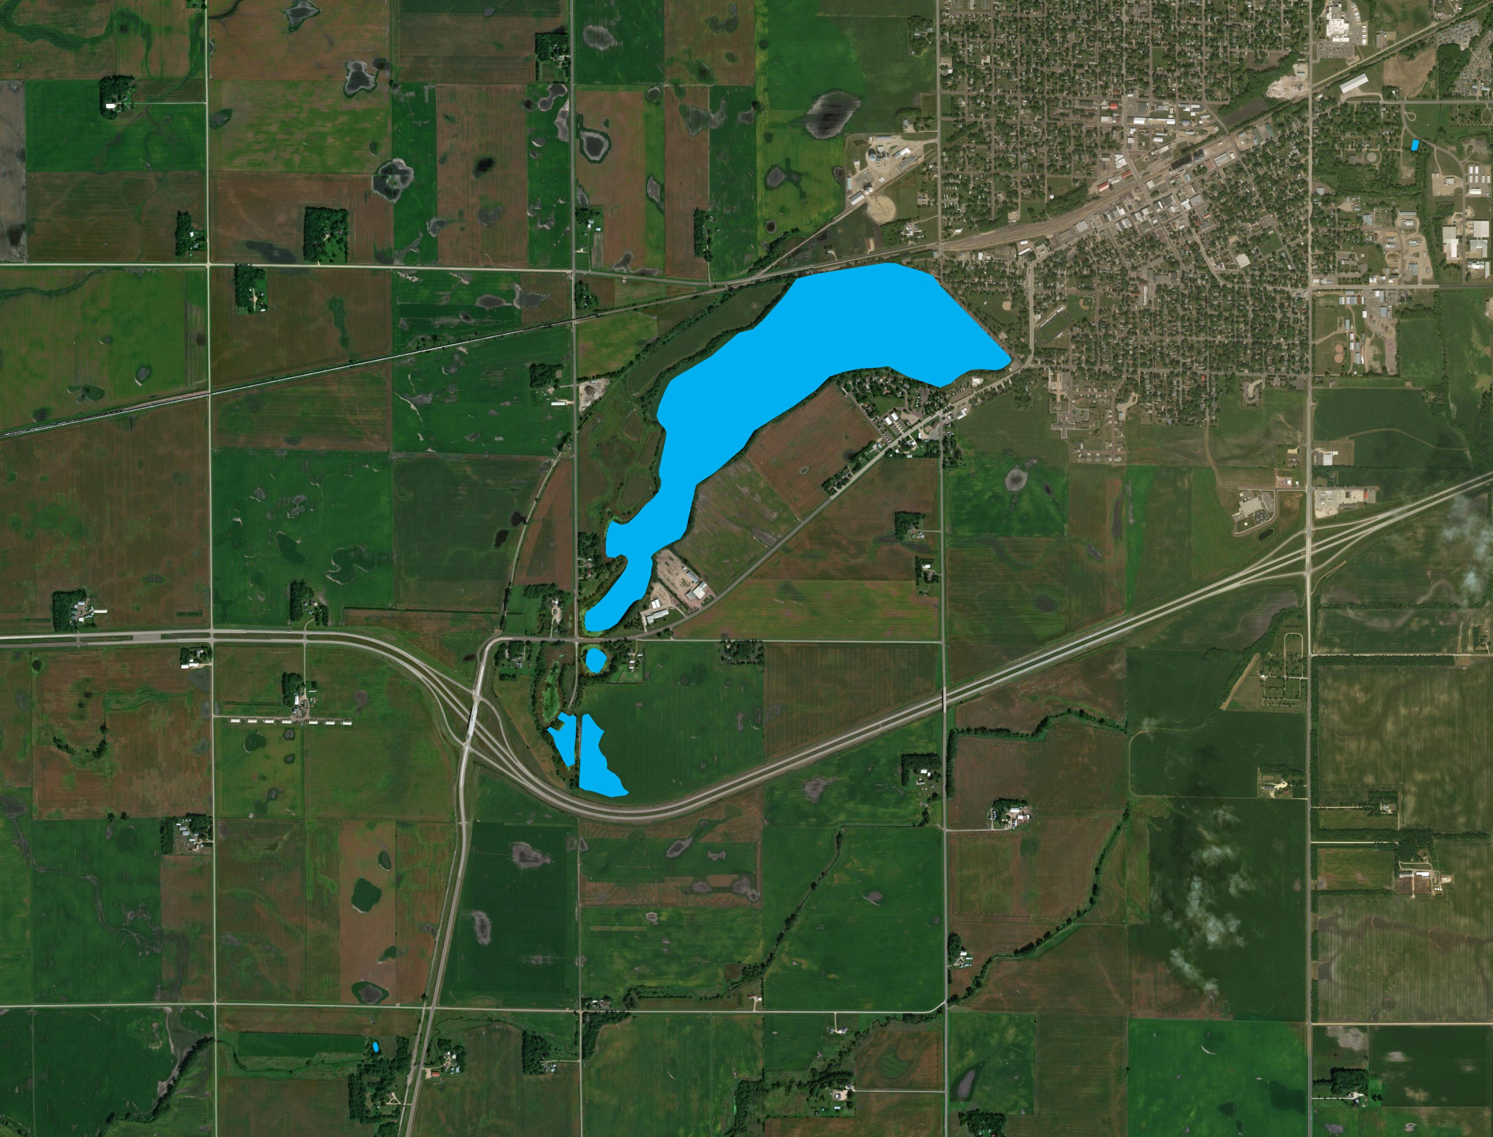
Deletions
2011
Notes:
MATT:
Our last set of images shows deletions.
This image shows features in 2011.

Slide 28
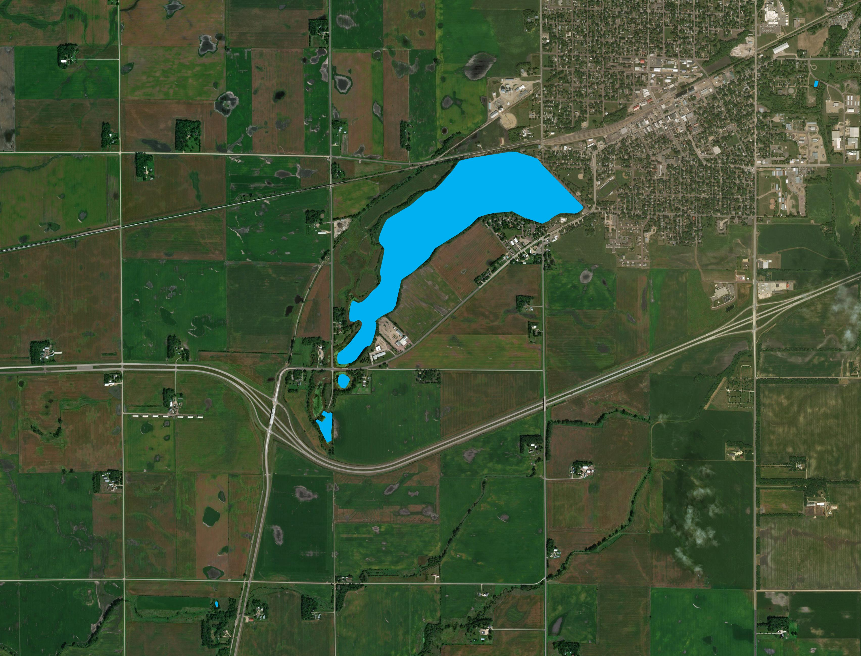
Deletions
2019
Notes:
MATT:
This image shows features in 2019

Slide 29

Deletions
2019
Notes:
MATT:
The feature that was deleted between 2011 and 2019 is shown in red.

Slide 30
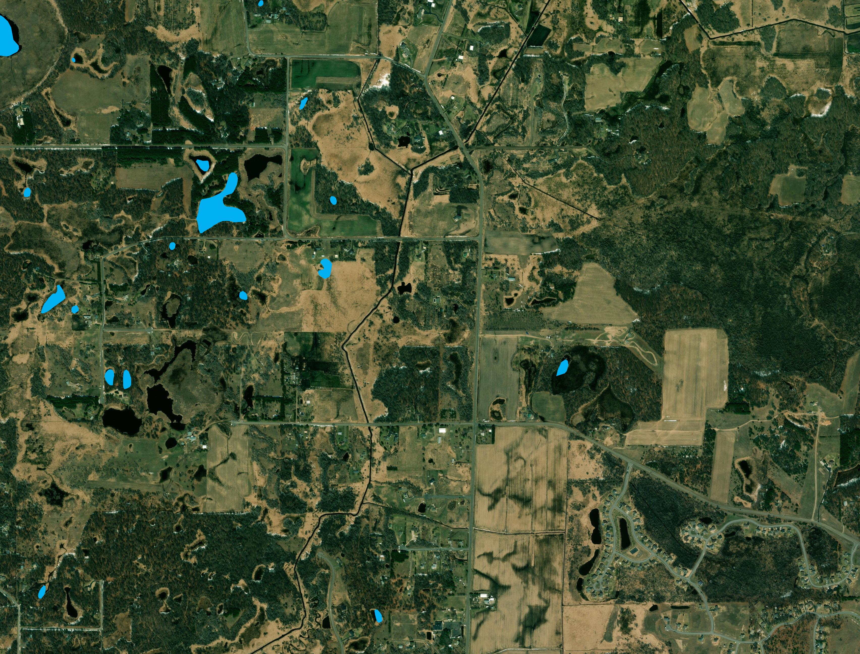
Additions
2011
Notes:
MATT:
Next we will be illustrating additions.
This image shows features in 2011.

Slide 31
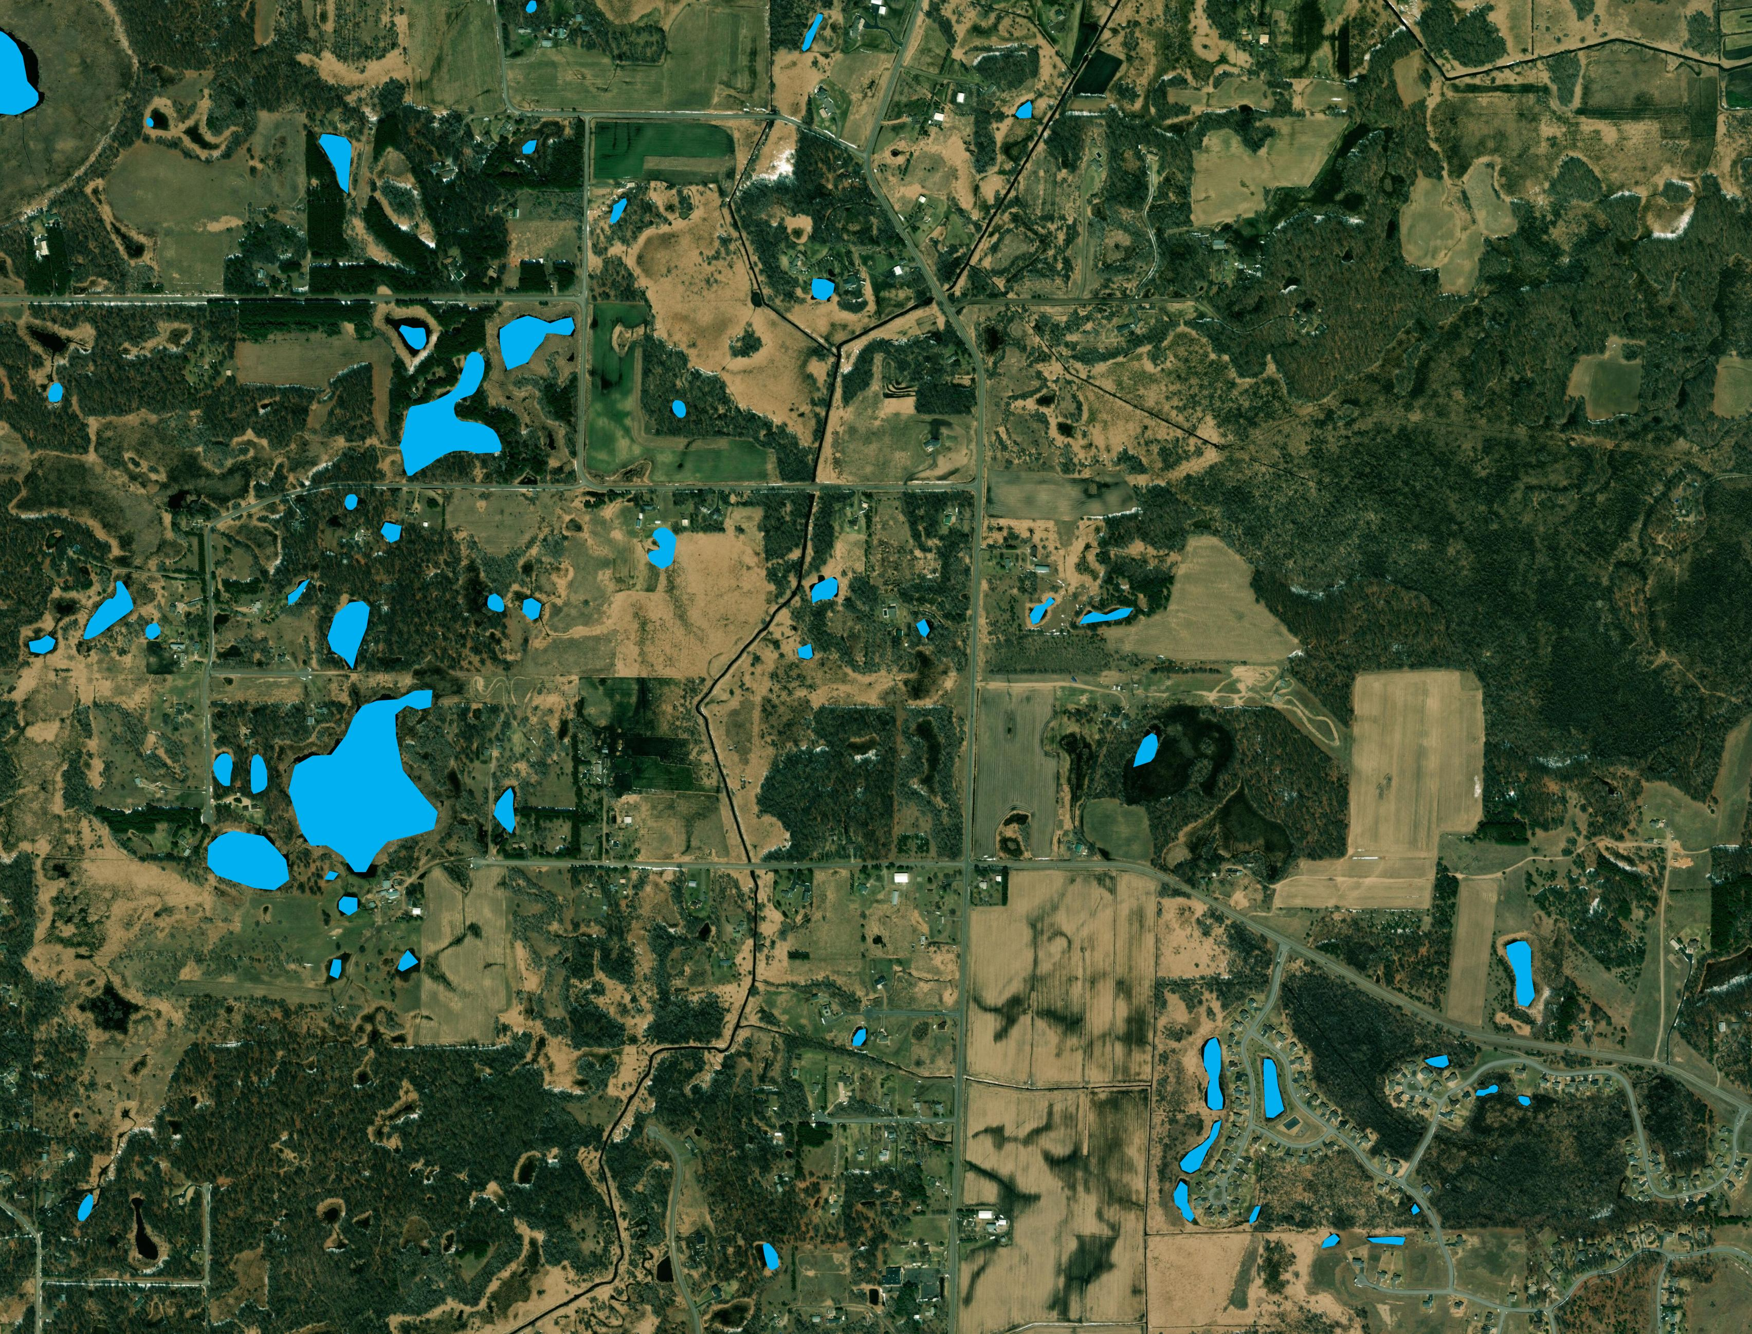
Additions
2019
Notes:
MATT:
And here we have features in 2019

Slide 32
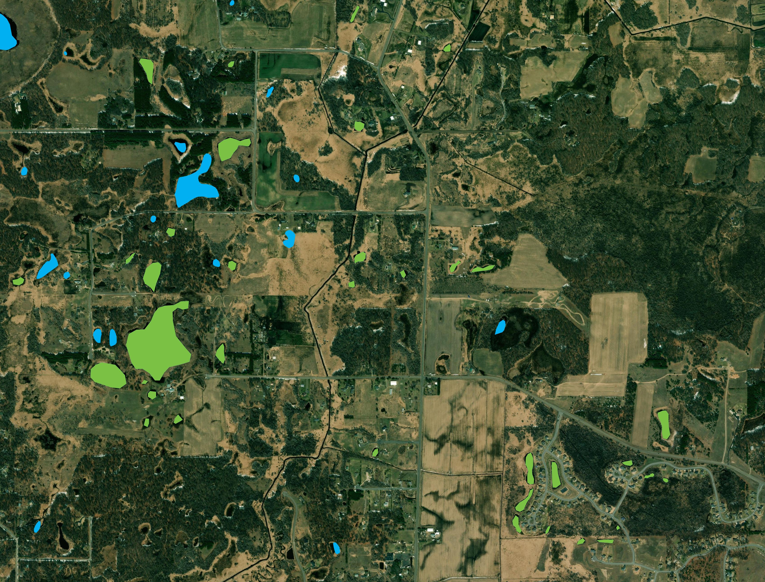
Additions
2019
Notes:
MATT:
And finally we have features that are considered additions shown in green.
These are features that were added between 2011 and 2019.

Slide 33

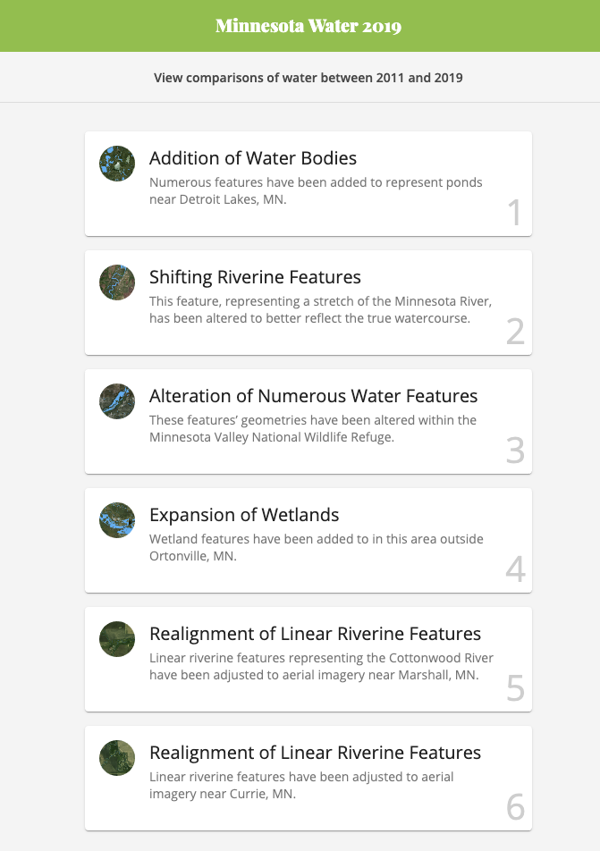
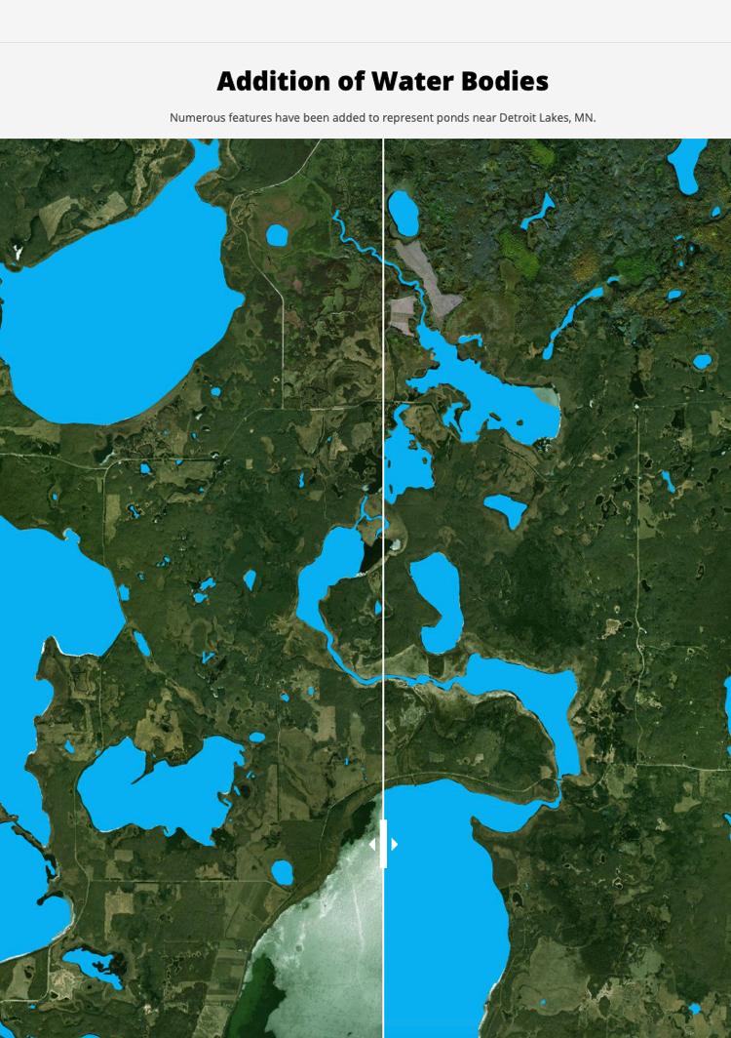
https://water.osmquality.io/
Notes:
MATT:
Next, we wanted to present a simple website with some examples of change that are displayed with a slider effect between 2011 and 2019

Slide 34
Summary of Findings
In 2019, the vast majority of OSM inland water data in Minnesota is sourced from NHD.
84% of polygonal data
98% of linear data
15% of NHD features changed between 2011-2019.
85% of NHD features remained unchanged between 2011-2019.
Notes:
MATT:
This chart shows the classification of linear features.
Again, the vast majority of linear features did not change from 2011-2019. However, a larger proportion of linear features changes than polygonal features.
The 17% that did change is comprised mostly of changes in geometry followed by additions, deletions, and replacements.

Slide 35
Conclusions
Bulk imports contribute to map completeness
Mindful, careful imports are a good thing
Combining rich datasets with the active OSM community creates an excellent opportunity to enhance data quality
Tracking features over time can be complicated
Notes:
MATT:
In conclusion, we learned just how important bulk imports can be for increasing the amount of OSM data in a given region
The combination of a rich wall-to-wall dataset like NHD with an active OSM community creates an excellent opportunity to enhance data quality
We also learned just how difficult it can be to track features over time due to processes like additions, deletions, and replacements.

Slide 36
Future Research
Analyzing how bulk imports affected editing rates
Comparing updated NHD data with OSM
Integrating a tagging time series analysis
Building an interactive viewer instead of static images
Notes:
MATT:
There is a lot of room for expanding this analysis in the future.
We are interested to know how bulk imported data affected editing rates in OSM. Can we test the hypothesis that bulk imports stifle community edits?
Another topic we are curious about is how data that is updated in parallel to OSM compares to OSM. Is there room for a validation feedback loop between NHD and OSM?
We did not take into consideration tag changes in this analysis. This would be a good topic to explore later.
Finally, we’d love to present our work in an interactive viewer rather than static images.

Slide 37
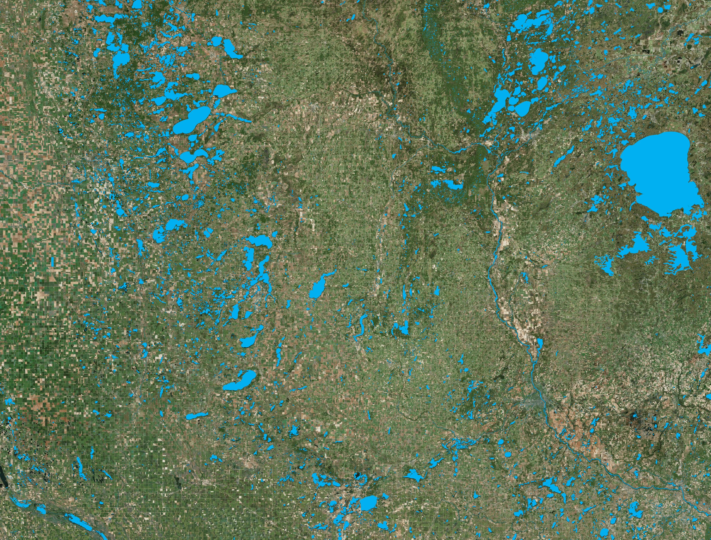

Acknowledgments
Alex Sweeney
Cole Bessee
Lukas Kucinski
Ahmed Ahmouda
Tianyi Ren
Monica Brandeis
Holly Moore
Todd Slind
Kim Kearns
Notes:
MATT:
We’d like to thank the Critigen team for there help making this project a reality.

Slide 38
Contact Info
www.critigen.com
matt.manley@critigen.com
bentley.breithaupt@critigen.com
alex.sweeney@critigen.com
Thank you!
Telephone
Stay Connected with Critigen
Office Phone: +1 (859) 312-9267
Address
1430 Summit Ave, Suite 100C
Seattle, WA 98122
Critigen MN Water Comparison Website:
https://water.osmquality.io/
Critigen MN Water Github Repo:
https://github.com/spatialdev/mn-water-2019
Notes:
MATT:
And with that we’d like to thank you for your attention and will leave you with some ways to stay connected with us
We will open it up to some questions at this point.

Slide 39
References
Juhász, L.; Hochmair, H.H. OSM Data Import as an Outreach Tool to Trigger Community Growth? A Case Study in Miami. International Journal of Geo-Information 2018, 7, 113.
Zielstra, D.; Hochmair, H.H.; Neis, P. Assessing the effect of data imports on the completeness of OpenStreetMap—A United States case study. Trans. GIS 2013, 17, 315–334.
Imports and the Community II, Matt’s Blog, 09/10/2009, https://web.archive.org/web/20140613144939/http://www.asklater.com/matt/wordpress/2009/09/imports-and-the-community-ii/index.html#more-179
Mooney, P.; Corcoran, P. The annotation process in OpenStreetMap. Trans. GIS 2012, 16, 561–579.

